Slide 1
Hardware Abstractions:
Gates and Logic
Notes:
*

Slide 2
Outline
A deeper look at basic hardware and software components.
Low-level hardware: Gates and Flip-flops.

Slide 3
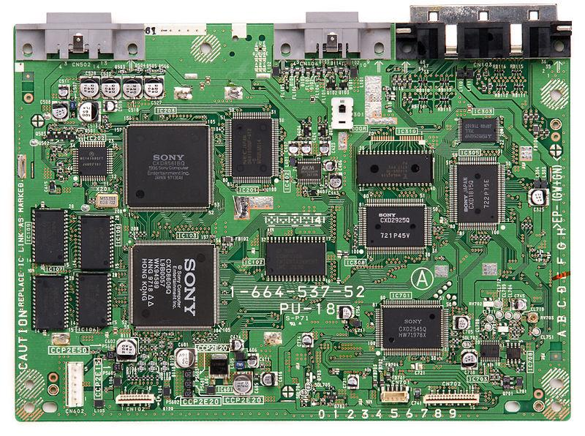
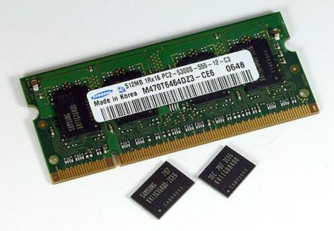
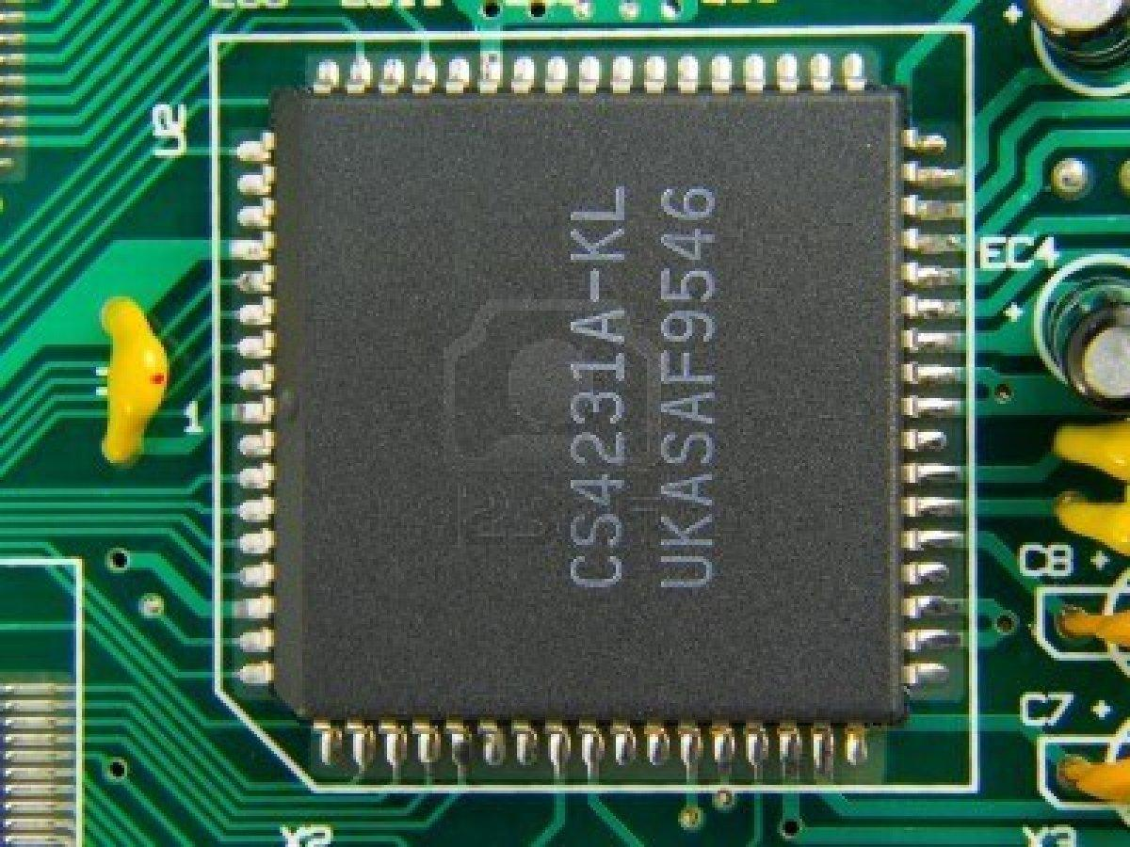
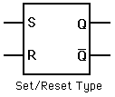
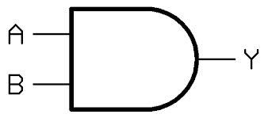
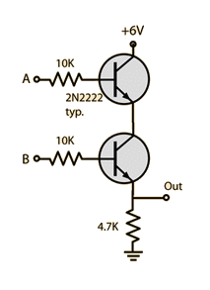
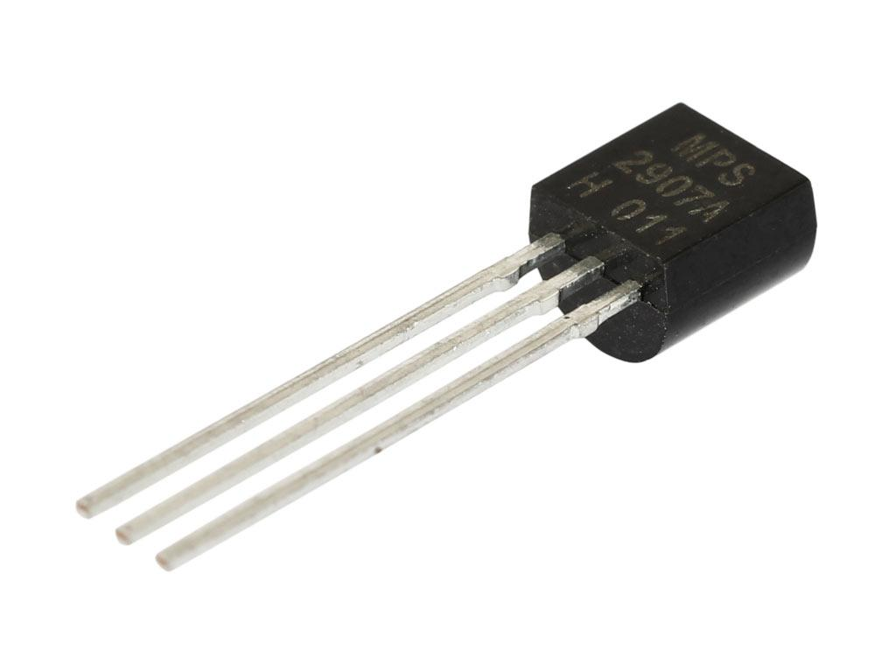
Hardware Abstraction Layers
Binary data is processed by physical layers of hardware.
Motherboard
High
Integrated circuits
Gates and flip-flops.
Electronic circuit
Low
Transistor

Slide 4
Bottom Up
Notes:
*

Slide 5
Hardware Abstraction Layers
Physical electronic circuits.
At the lowest level, physicists and electrical engineers develop materials and design and build electronic circuits that are composed of transistors, the fundamental building block of electronic devices.

Slide 6
Hardware Abstraction Layers
Gates and flip flops.
Computer scientists and electrical engineers combine basic circuits into basic computational elements, such as AND gates and S/R flip flops.

Slide 7
Hardware Abstraction Layers
Integrated Circuits (ICs).
Electrical and computer engineers combine low-level elements into complex integrated circuits or computer chips.

Slide 8
Hardware Abstraction Layers
Functional Component
RAM (Random Access Memory)
At the highest levels, computer engineers create ICs for specific functions, such as RAM.

Slide 9
Hardware Abstraction Layers
The Computer
An integrated system of functional components.
Sony Playstation Motherboard

Slide 10
Gates
A gate is a tiny electronic circuit that performs a basic logic operation.
Notes:
*

Slide 11
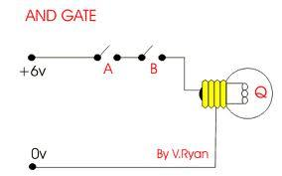
The Physical AND Gate
AND Gate – the light is on when both switches, A and B, are closed

Slide 12
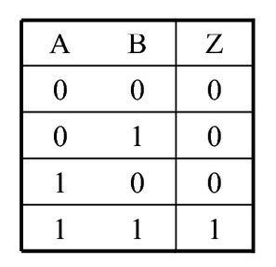
The Logical (Boolean) AND Gate
Z
Light is on only when both A and B are closed
}
Z is false in all cases except…
when A and B are both true.
Truth Table
1 = true, 0 = false

Slide 13
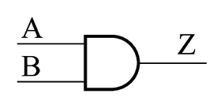
The Symbol for AND
Z
Light on only when both A and B are closed

Slide 14
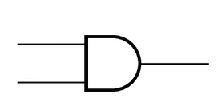
Abstractions for AND
High-level: just a symbol
Mid-level: an abstraction of the logical behavior
Low-level: an abstraction of the physical electronics.

Slide 15
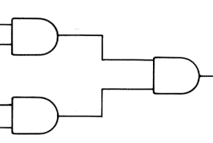
Why Abstraction?
Once you know that
means
you can use the more abstract symbol to build more complex models and designs.

Slide 16

Abstraction
An abstraction is a general representation of something.
Abstracting is the process of leaving out details in order to simplify a concept.
“chair”

Slide 17
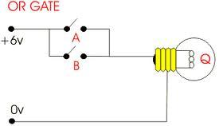
The Physical OR Gate
OR Gate – the light is on when either or both switches A or B are closed.

Slide 18
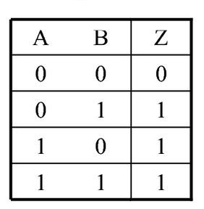
The Logical (Boolean) OR Gate
Z
Light is off only when both A and B are open.
Z is False when both A and B are false.
}
Z is True in all other cases.
Truth Table
1 = true, 0 = false

Slide 19
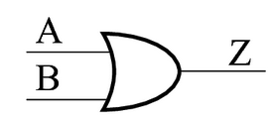
The Symbol for OR
Z
Light off only when both A and B are open

Slide 20
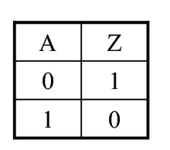
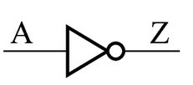
NOT Gate
NOT Gate – Z is true when A is false and vice versa.

Slide 21

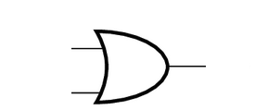
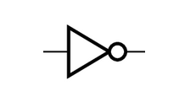
Abstraction
All electronic components are built by combining these three basic gates!!

Slide 22

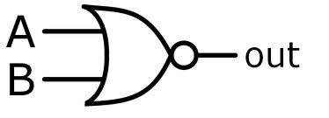
Example: NAND and NOR Gates
+
=
NAND Gate
+
=
NOR Gate

Slide 23
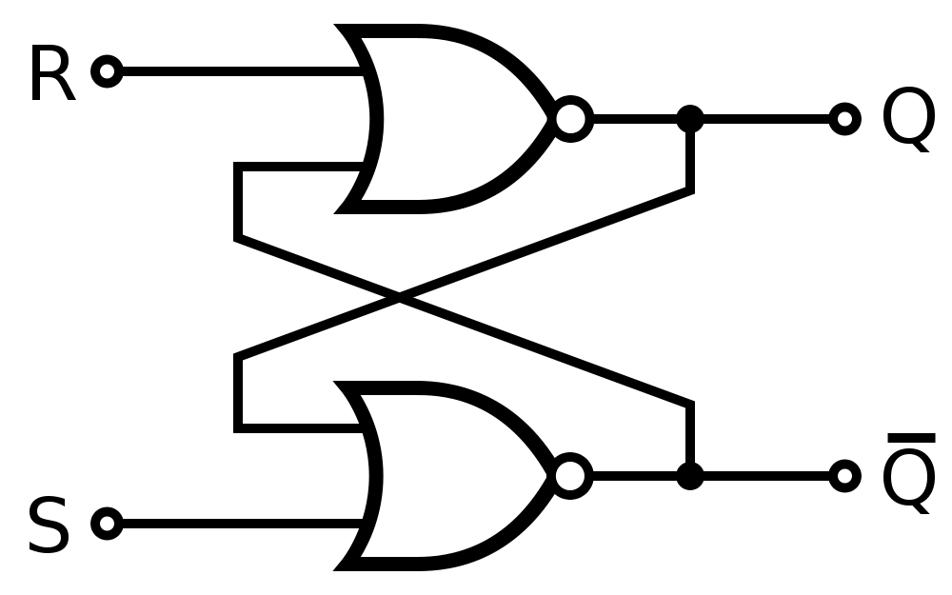
Example: A Flip Flop Circuit
A flip-flop or latch is circuit that has two-states and can be used to store 1 bit of data, a 0 or a 1.
Reset
Stored Bit
a 0 or 1
Set
A Set/Reset Flip Flop
A high pulse on Set, stores 1, a high pulse on Reset stores 0.

Slide 24
And that’s a quick look
under the hood!
Notes:
*

Slide 25
Matching Activity
Match the technical terms with their definitions
Technical Term | Definition or description
RAM | A gate is a tiny electronic circuit that performs a basic logic operation.
CPU | A logic abstraction that defines the behavior of a gate.
Gate | Electronic component that corresponds to a logic element that is TRUE when either or both of its inputs, A and B, are TRUE.
Truth table | Stores the computer's programs and data temporarily while power is on
AND Gate | The process of leaving out details in order to represent a concept.
OR Gate | A two-state circuit that can store 1 bit of binary information.
Abstracting | Electronic component that corresponds to a logic element that is TRUE only when both of its inputs, A, and B, are TRUE.
Flip flop | Performs the fetch/execute cycle to run machine language programs.
Notes:
*

